Slide 1
Blurred Lines
It’s not just important that you serve, it’s equally important, how you serve.
Serve Well!
Ethical Considerations

Slide 2
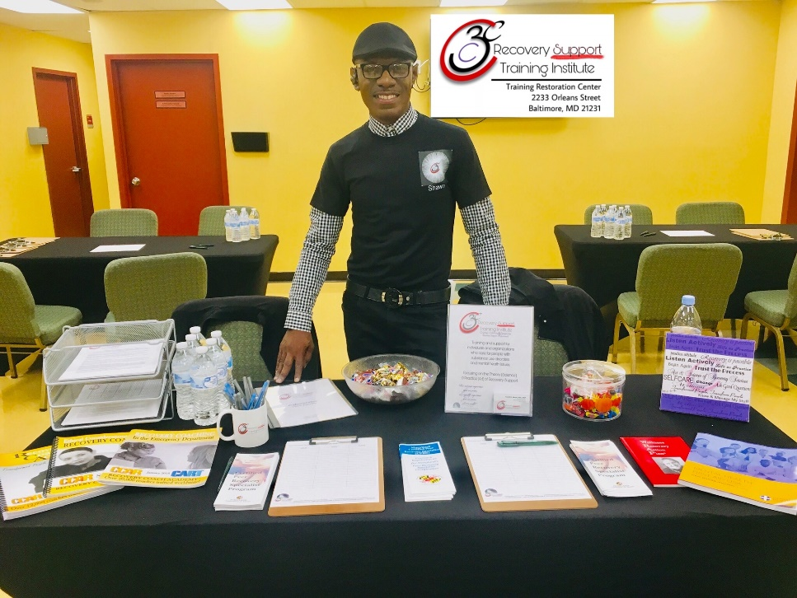
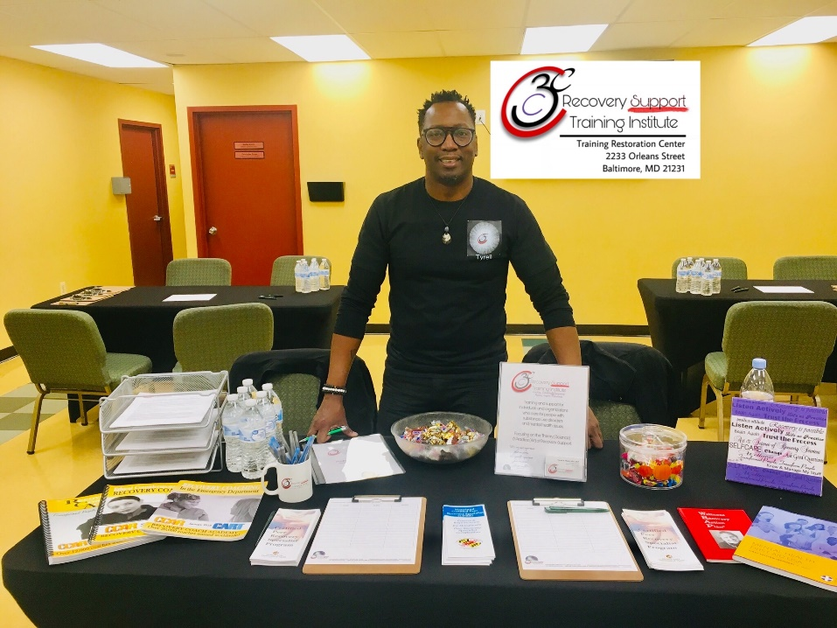
Shawn Pringle, CPRS, PRS
Tyrell D. Moyd, RPS, RCP

Slide 3
Today, we will:
Discuss the decision making process when ethical issues arise.
Define a few roles of a Recovery Coach and how they relate to ethical issues.
Recognize boundary management issues and identity some appropriate courses of action.
Ethical Considerations: Blurred Lines

Slide 4
Making Ethical Decisions
Who can be harmed? Who benefits?
Is this course of action fair to all?
Is there a justifiable reason to perform or not to perform this action?
Does this course of action violate any federal, local or agency policies and procedures/laws (e.g. HIPPA, mandatory reporting, MABPCB standards)
Ethical Considerations: Blurred Lines

Slide 5
Define these RC roles
Advocate
Ally and Confidant
Friend and Companion
Lifestyle Consultant
Role Model and Mentor
Ethical Considerations: Blurred Lines

Slide 6
Scenario
You show up for group, the counselor says random urines need to be completed and asks you to monitor/observe the urinalysis. How do you respond?
“Let me run this by my supervisor.”
“That puts me in a hierarchical position with the person I am serving and my role is one of equal support.”
Ethical Considerations: Blurred Lines

Slide 7
Scenario
What do you do when your supervisor/manager/agency asks you to do something that you question might be unethical?
Respectfully question appropriateness
Follow the chain of command of agency
Contact MABPCB to inquire about appropriateness
Contact BHA to inquire about appropriateness
Contact other Local Agencies (BHSB)
Ethical Considerations: Blurred Lines

Slide 8
?
Questions & Comments
?
?
?
?
Thank You!
?
?
?

Slide 9
Thank You!

