Slide 1
Maryland Situation Update on Coronavirus Disease (COVID-19) for BHA
Maryland Department of Health
Infectious Disease Epidemiology and Outbreak Response Bureau
September 18th, 2020

Slide 2
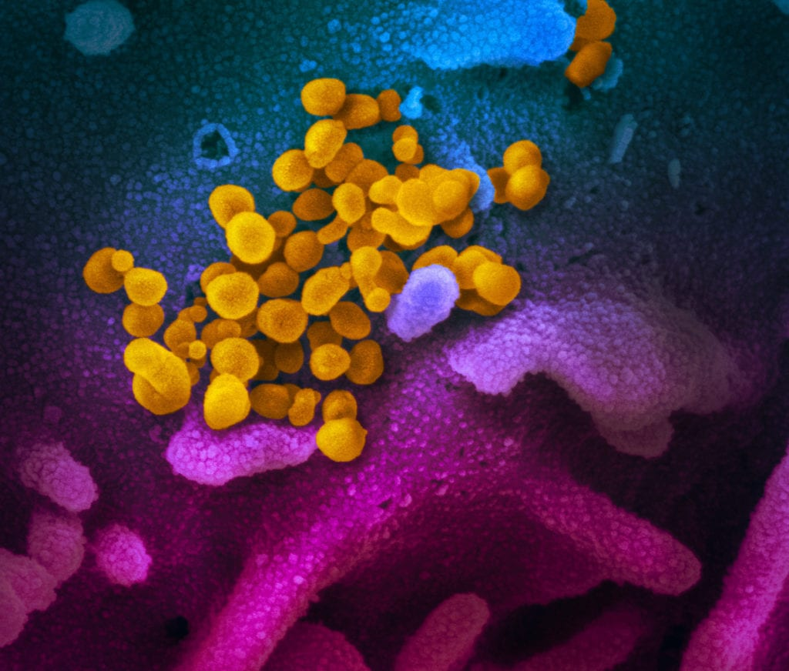
Call Agenda
Picture Courtesy of NIAID-RML
Review current situation of COVID-19
Long Haulers
Questions and Answers

Slide 3
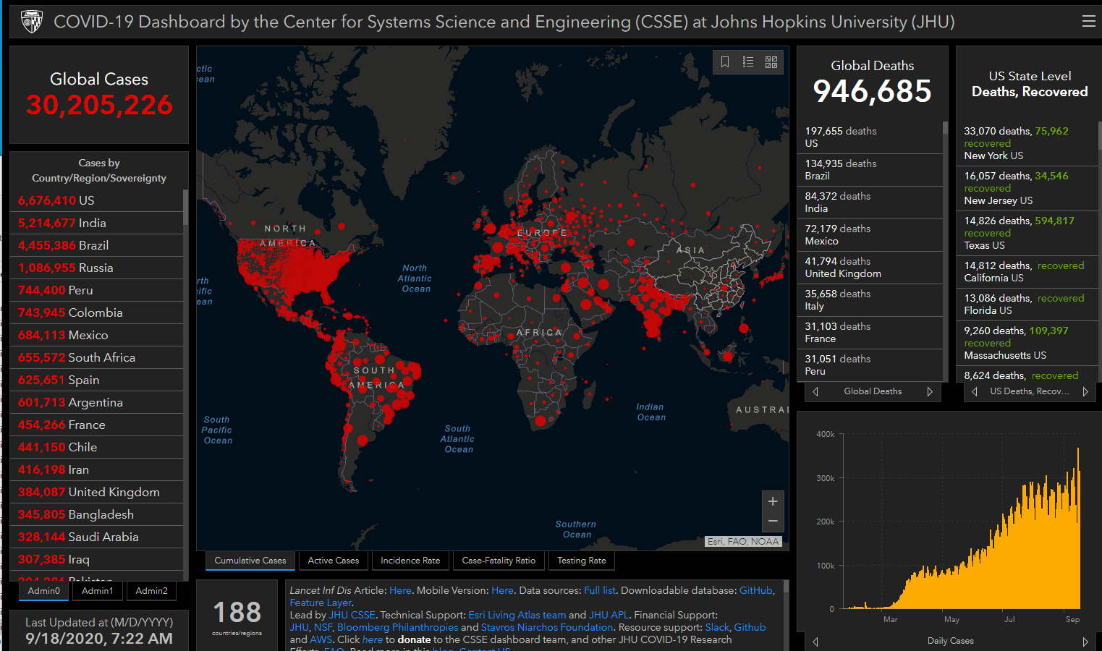
COVID-19 Global Situation Summary

Slide 4
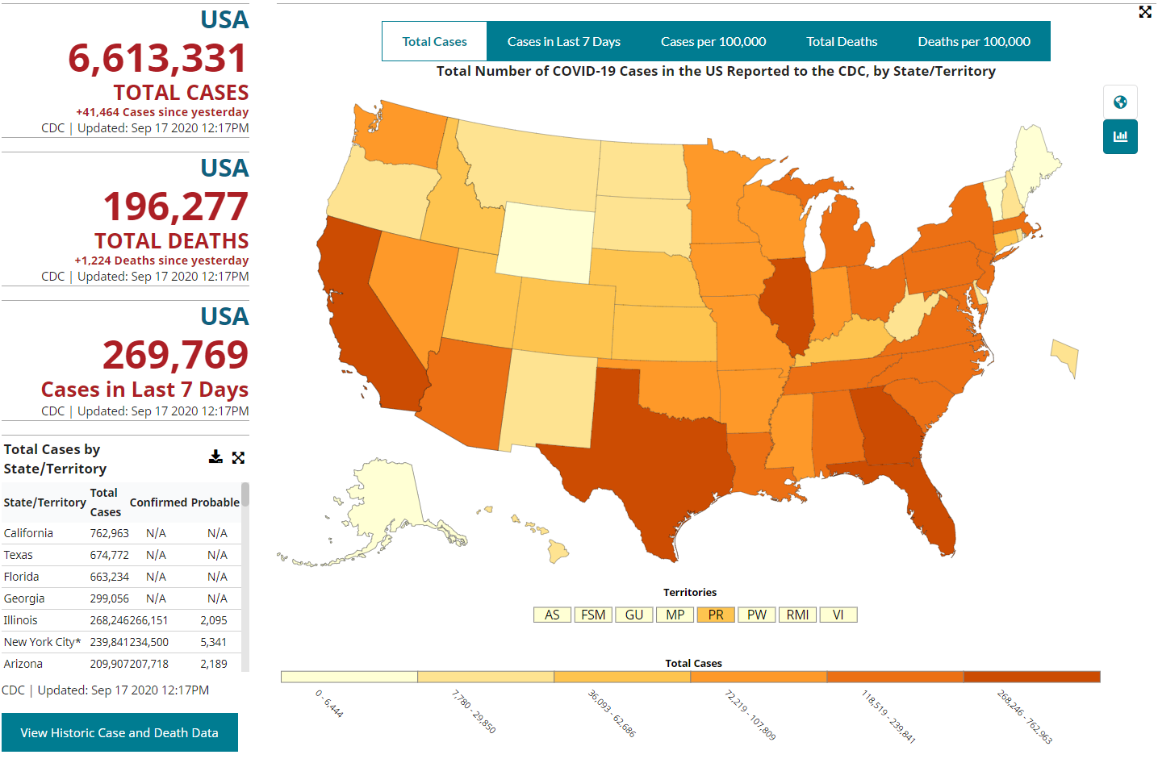
U.S.: COVID-19 Cases
https://www.cdc.gov/coronavirus/2019-ncov/cases-updates/cases-in-us.html Accessed 9/18/2020

Slide 5
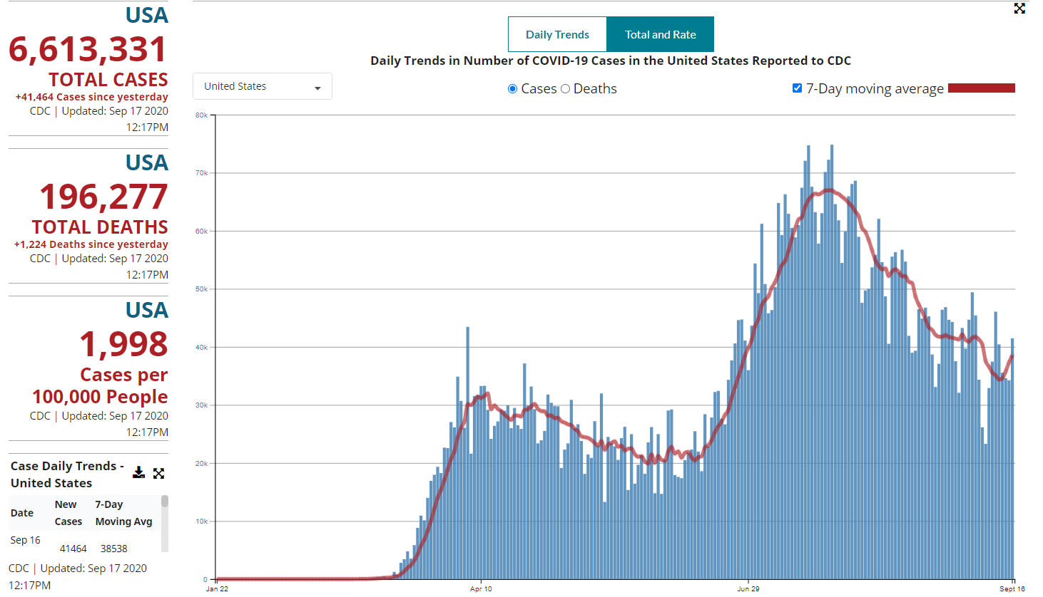
Number of Cases Reported in the USA, by Day

Slide 6
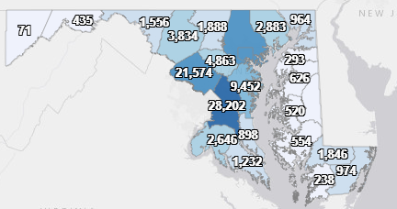
Maryland: COVID-19 Cases
http://health.maryland.gov/coronavirus
Data current as of 9/11/2020
Cases: 119,062
543 new
Deaths: 3,724
7 new
Hospitalizations: 15,070
Current: 347
62 new
Total tests 2,324,252

Slide 7
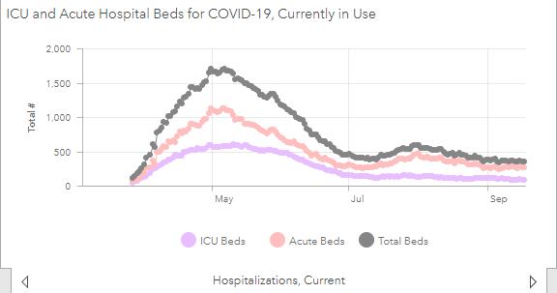

Slide 8
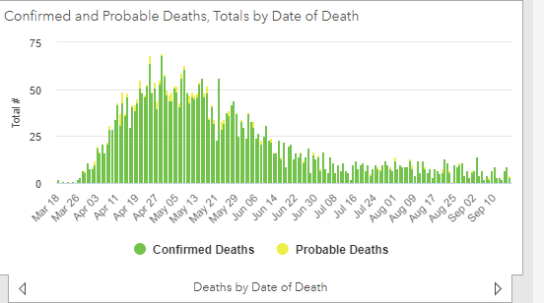

Slide 9
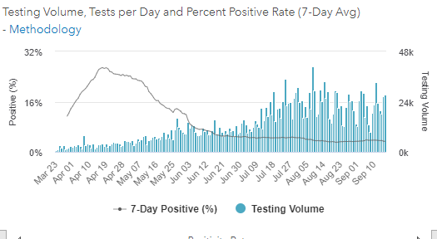
Testing Volume and % Positivity

Slide 10
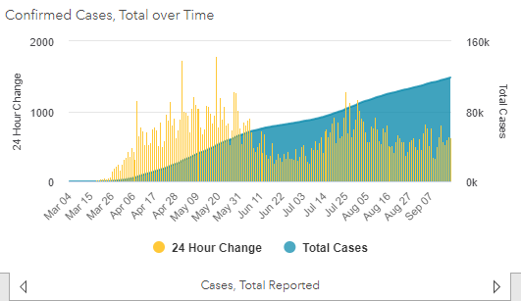

Slide 11
Long Haulers

Slide 12
“Long Haulers”
People who have recovered from acute COVID-19 infection but report lingering symptoms, ranging from mild to severe
May be as frequent as 1 in 5 previously healthy young adults
Long Haul symptoms may not correspond with severity of original disease
Residual symptoms may include:
Chronic Fatigue
Cardiomyopathy
Neurological complications including cognitive difficulties, memory loss
Abnormal lung function, SOB
Decreased immune function
https://www.cdc.gov/mmwr/volumes/69/wr/mm6930e1.htm
https://www.nature.com/articles/d41586-020-02598-6

Slide 13
Long Haulers: Testing
Recommendation to not re-test previously positive cases within 90 days UNLESS the are symptomatic
Challenge is defining symptomatic
Long Haulers may or may not test positive by PCR
What does a positive mean in a person with residual symptoms
Residual traces of RNA and not infectious?
Small amount of lingering virus and mildly infectious?
What does a negative mean in a person with residual symptoms
Virus has cleared?

Slide 14
Long Haul Infection Control Questions
CDC Criteria to discontinue precautions, exclusions in symptomatic people:
10 days since symptom onset
24 hours fever free
Improvement of other symptoms
What happened if the “other symptoms” have not improved weeks/months later?
Consider this as a place to use a test based strategy
ID consult
Consult with Public Health
Keep an eye on the science: More to come

Slide 15
Community Contact Exposures
Contacts in the community can contribute to spread of COVID-19
Early results from a case control study looking at exposures
Symptomatic patients seeking care at one of 11 different facilties
Restaurant dining (indoor and outdoor) was reported in 42% of cases and 12% of controls
42% of cases reported close contact with a known COVID-19 case, mostly in households
https://www.cdc.gov/mmwr/volumes/69/wr/mm6936a5.htm

Slide 16
COVID-19 and Pregnancy
Among 598 hospitalized pregnant people with COVID-19, 55% were symptomatic
16% were admitted to the ICU
8% required mechanical ventilation
1% death rate
2% fetal loss rate, and occur among both symptomatic and asymptomatic patients
Pregnant people should be aware of the risks of COVID, and take precautions
Providers should observe pregnant patients for potential COVID infection and complications
https://www.cdc.gov/mmwr/volumes/69/wr/mm6938e1.htm?s_cid=mm6938e1_w

Slide 17
Resources
MDH Novel Coronavirus: http://health.maryland.gov/coronavirus
MDH Laboratory Coronavirus: https://health.maryland.gov/laboratories/Pages/Novel-Coronavirus.aspx
COVID-19 People at risk https://www.cdc.gov/coronavirus/2019-ncov/specific-groups/high-risk-complications.html
CDC Guidance for Infection Control https://www.cdc.gov/coronavirus/2019-nCoV/infection-control.html
Behavioral Health https://www.cdc.gov/coronavirus/2019-ncov/hcp/infection-control-faq.html?CDC_AA_refVal=https%3A%2F%2Fwww.cdc.gov%2Fcoronavirus%2F2019-ncov%2Finfection-control%2Finfection-prevention-control-faq.html
Memory Care https://www.cdc.gov/coronavirus/2019-ncov/hcp/memory-care.html

Slide 18
Questions?
Email : mdh.ipcovid@Maryland.gov

