Slide 1
Maryland Situation Update on Coronavirus Disease (COVID-19) for BHA
Maryland Department of Health
Infectious Disease Epidemiology and Outbreak Response Bureau
September 11th, 2020

Slide 2
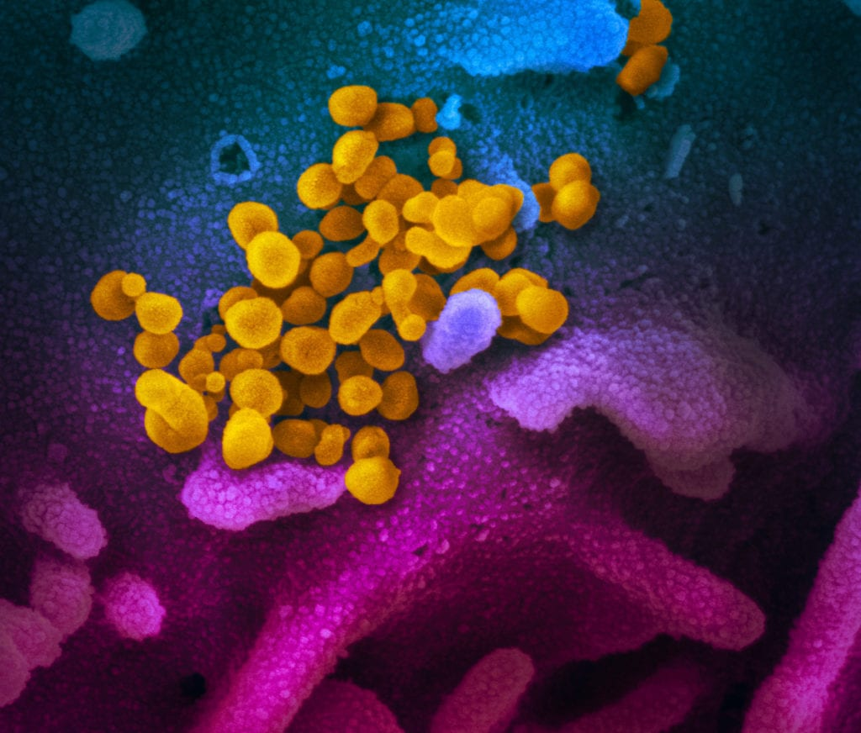
Call Agenda
Picture Courtesy of NIAID-RML
Review current situation of COVID-19
Addressing COVID fatigue
Flu Vaccine
Questions and Answers

Slide 3
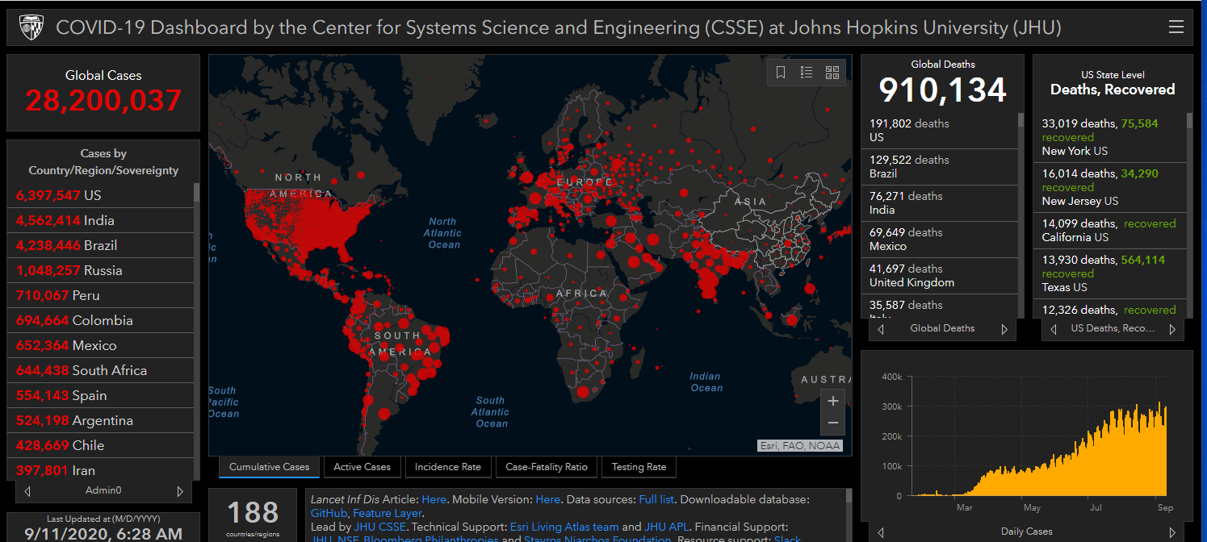
COVID-19 Global Situation Summary

Slide 4
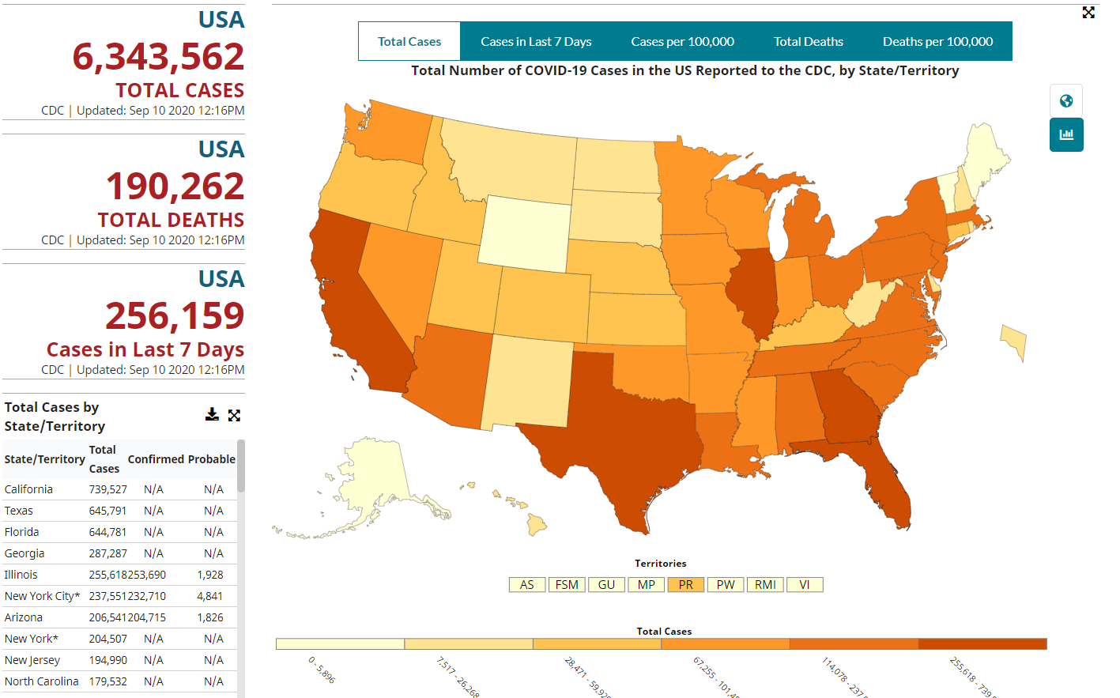
U.S.: COVID-19 Cases
https://www.cdc.gov/coronavirus/2019-ncov/cases-updates/cases-in-us.html Accessed 9/11/2020

Slide 5
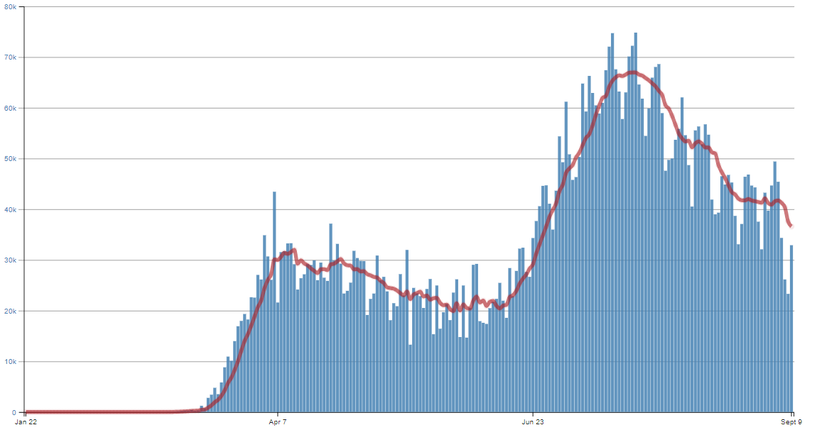
Number of Cases Reported in the USA, by Day

Slide 6
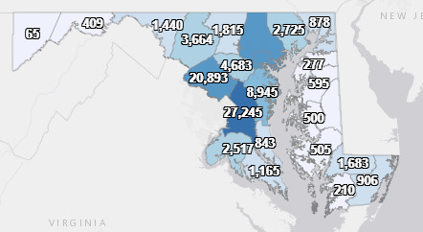
Maryland: COVID-19 Cases
http://health.maryland.gov/coronavirus
Data current as of 9/11/2020
Cases: 114,724
646 new
Deaths: 3,685
6 new
Hospitalizations: 14,184
Current: 369
50 new
Total tests 2,150,638

Slide 7
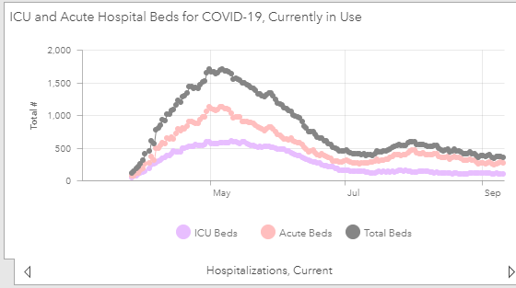

Slide 8
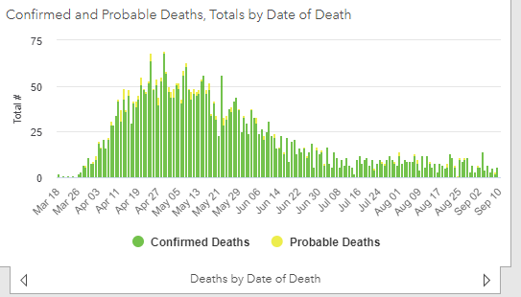

Slide 9
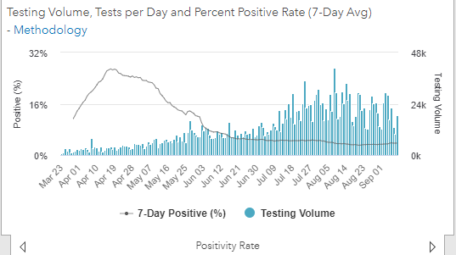
Testing Volume and % Positivity

Slide 10
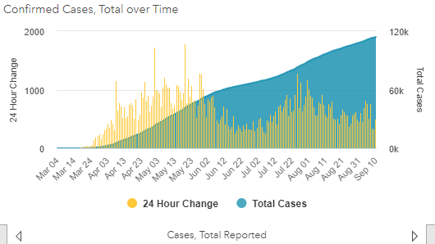

Slide 11
Maryland Updates

Slide 12
Stage 3 of Maryland reopening
June 10th Governor Hogan announced that Maryland will begin entry into stage 3 of reopening.
INDOOR THEATERS may open to the general public at 50% capacity, or 100 people per auditorium—whichever is less—with appropriate health and safety protocols in place.
OUTDOOR VENUES may open to the general public at 50% capacity, or 250 people—whichever is less—with appropriate health and safety protocols in place.
RETAIL AND RELIGIOUS FACILITIES. Capacity for retail establishments and religious facilities may increase from 50 to 75 percent.
https://governor.maryland.gov/2020/09/01/governor-hogan-announces-beginning-of-stage-three-of-marylands-covid-19-recovery-additional-safe-and-gradual-reopenings/

Slide 13
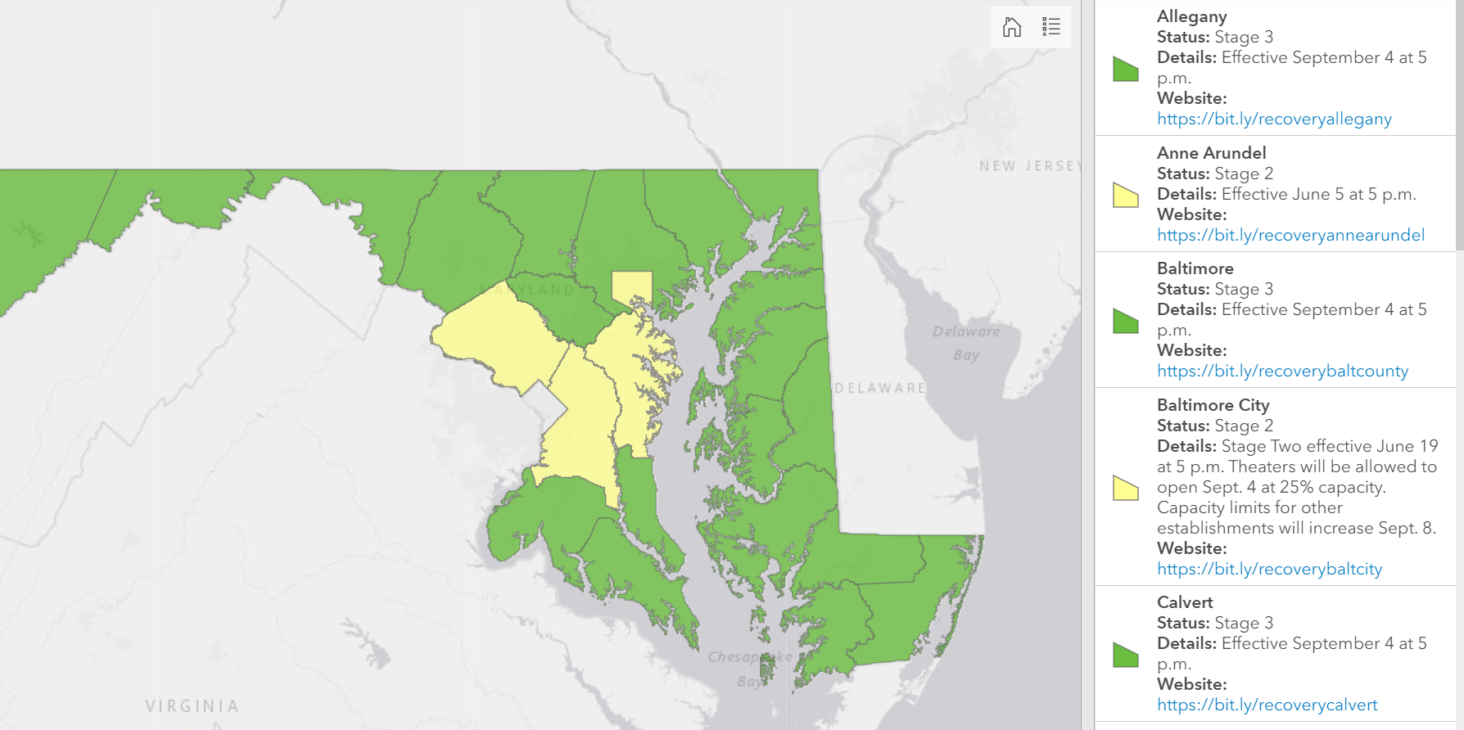
Maryland Reopening Status
Source: https://governor.maryland.gov/recovery/, Accessed September 8, 2020

Slide 14
School Guidance Update
September 1, 2020

Slide 15
New Schools Guidance
Additional school guidance documents:
Response to a Laboratory Confirmed Case of COVID-19 and Persons with COVID-19-like Illness in Schools - UPDATED
Guidance for Temperature and Symptom Screening in Schools - NEW
Use of Cloth Face Coverings in Schools – UPDATED
All of these documents can be found at https://coronavirus.maryland.gov/pages/school-resources

Slide 16
Decision Aid
“Decision Aid: Exclusion and Return for Laboratory Confirmed COVID-19 Cases and Persons with COVID-19-like Illness in School, Child Care Programs, and Youth Camps”

Slide 17
UPDATED - COVID-19-like Illness definition
For the purposes of this decision aid, COVID-19-like illness is defined as: Any 1 of the following: cough, shortness of breath, difficulty breathing, new loss of taste or smell, OR At least 2 of the following: fever of 100.4º or higher (measured or subjective), chills or shaking chills, muscle aches, sore throat, headache, nausea or vomiting, diarrhea, fatigue, and congestion or runny nose.

Slide 18
Influenza Vaccination
Flu shots are now available at doctors’ offices, pharmacies, urgent cares, etc
CDC recommends that everyone over 6 months old gets a flu vaccine
Talk with your healthcare provider about which vaccine is best for you
Best timing is in September and October
It is never too late to get a flu shot
https://www.cdc.gov/flu/prevent/keyfacts.htm

Slide 19
COVID Fatigue
As the pandemic goes on, it gets harder to remember to maintain a heightened awareness of the need for precautions
At the beginning, fear, hypervigilance, novelty, constant messaging, kept many people engaged in prevention efforts
Most people can not maintain that level of intense engagement
Especially people who have not been directly impacted
People more likely to maintain precautions:
know someone who got COVID
got COVID themselves
lost someone to COVID
(work in public health)

Slide 20
How to Fight COVID Fatigue
Commit to behavior change
Keep up with the science using reliable news sources
Be flexible when the science changes the recommendations
Make a new habit
Keep supplies handy and available
If you need motivation, read a story from someone directly impacted
https://www.hopkinsmedicine.org/health/conditions-and-diseases/coronavirus/how-to-deal-with-coronavirus-burnout-and-pandemic-fatigue

Slide 21
Behavior Changes from Public Health
This disease is not going away anytime soon, but we can make changes in behavior:
Seatbelt use
Car seats
Bike helmets
Safer sex
No smoking in public places
One day soon: universal correct mask use

Slide 22
Resources
MDH Novel Coronavirus: http://health.maryland.gov/coronavirus
MDH Laboratory Coronavirus: https://health.maryland.gov/laboratories/Pages/Novel-Coronavirus.aspx
COVID-19 People at risk https://www.cdc.gov/coronavirus/2019-ncov/specific-groups/high-risk-complications.html
CDC Guidance for Infection Control https://www.cdc.gov/coronavirus/2019-nCoV/infection-control.html
Behavioral Health https://www.cdc.gov/coronavirus/2019-ncov/hcp/infection-control-faq.html?CDC_AA_refVal=https%3A%2F%2Fwww.cdc.gov%2Fcoronavirus%2F2019-ncov%2Finfection-control%2Finfection-prevention-control-faq.html
Memory Care https://www.cdc.gov/coronavirus/2019-ncov/hcp/memory-care.html

Slide 23
Questions?
Email : mdh.ipcovid@Maryland.gov

