Slide 1
Maryland Situation Update on Coronavirus Disease (COVID-19) for BHA
Maryland Department of Health
Infectious Disease Epidemiology and Outbreak Response Bureau
August 14th, 2020

Slide 2
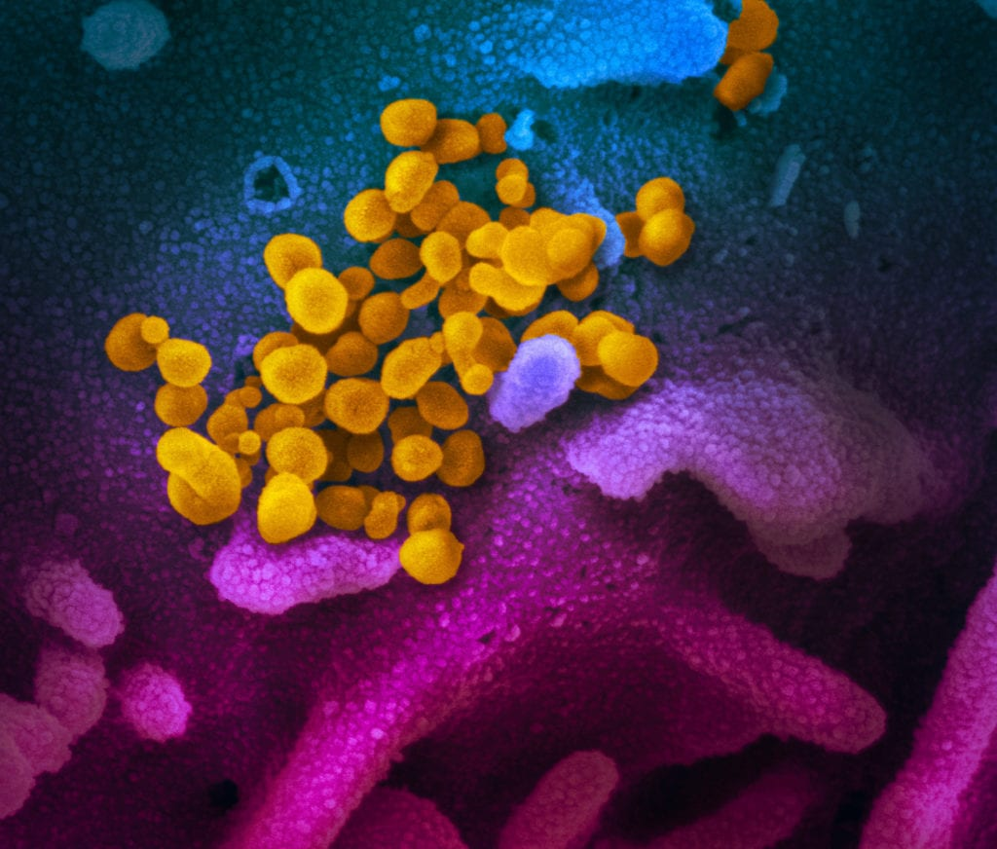
Call Agenda
Picture Courtesy of NIAID-RML
Review current situation of COVID-19
COVIDlink
CDC State Data
Questions and Answers

Slide 3
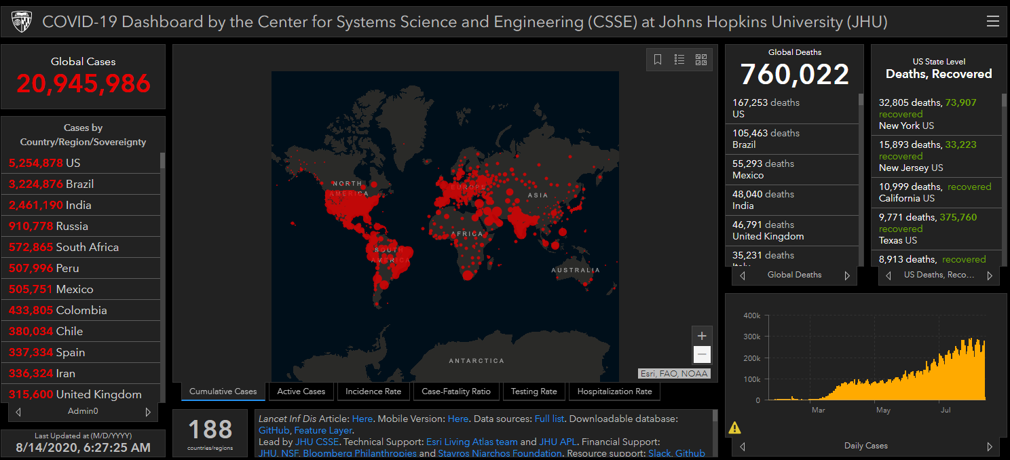
COVID-19 Global Situation Summary

Slide 4
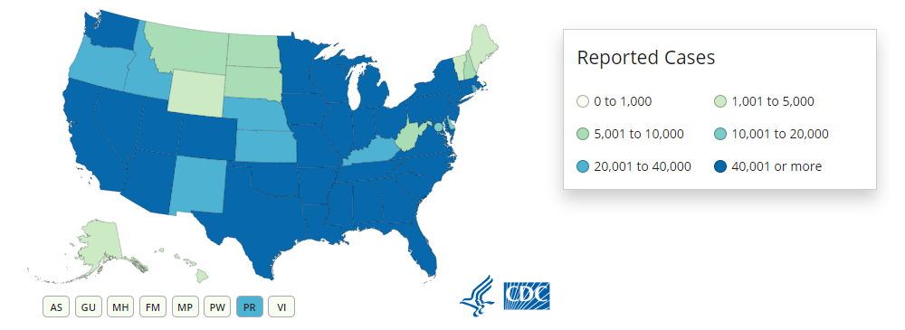
U.S.: COVID-19 Cases
5,176,018 Confirmed Cases
56,307 new
165,148 total deaths
1,497 new
https://www.cdc.gov/coronavirus/2019-ncov/cases-updates/us-cases-deaths.html
Accessed 8/14/2020

Slide 5
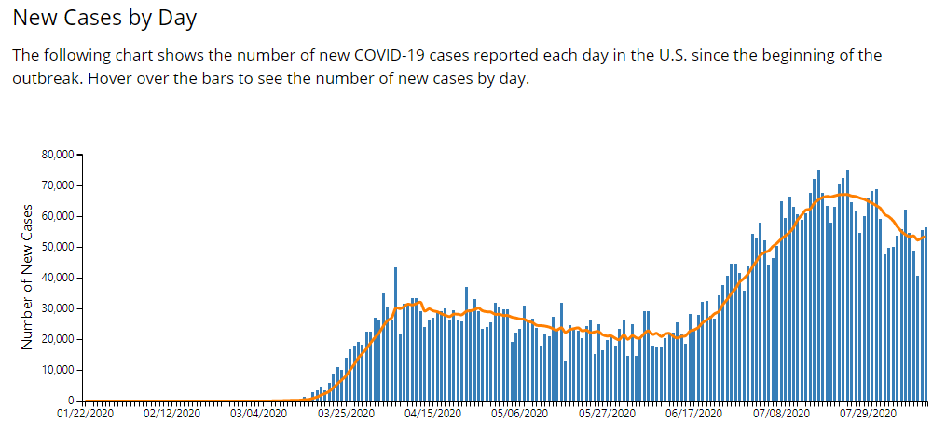

Slide 6
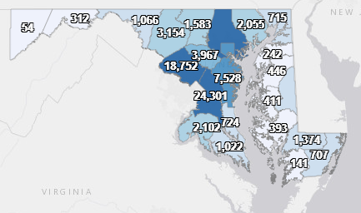
Maryland: COVID-19 Cases
http://health.maryland.gov/coronavirus
Data current as of 8/14/2020
Cases: 98,975
715 new
Deaths: 3,495
12 new
Hospitalizations: 13,508
Current: 457
45 new
Total tests 1,557,609
Total people tested: 1,110,273

Slide 7
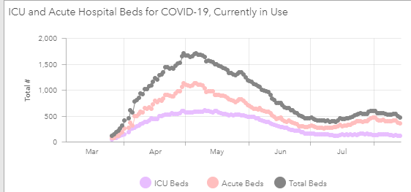

Slide 8
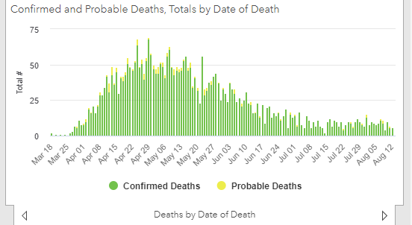

Slide 9
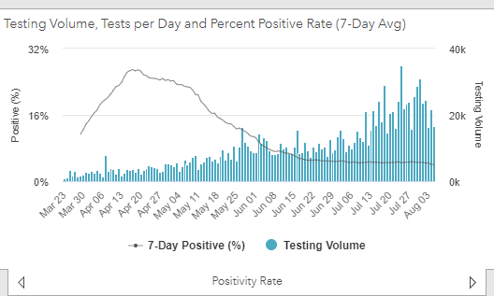
Testing Volume and % Positivity

Slide 10
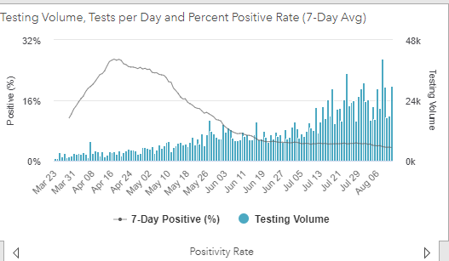

Slide 11
Mental Health, Substance Use, and Suicidal Ideation During the COVID-19 Pandemic
COVID-19 has created a unique set of mental health challenges in the population
Associated with:
Morbidity and mortality of disease
Impacts of social distancing and stay at home orders
Study looks at
Substance use
Trauma and stress related disorder
Anxiety disorder and depressive disorder
Suicidal ideation
https://www.cdc.gov/mmwr/volumes/69/wr/mm6932a1.htm?s_cid=mm6932a1_w

Slide 12
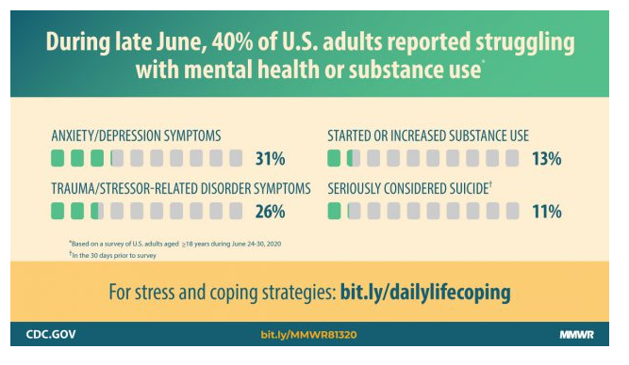

Slide 13
The Study
5,412 adults completed online survey between June 24-June 30
Anxiety and depression were assessed using the 4 item Patient Health Questionnaire
COVID-19 related TSRD assessed using 6 item Impact of Event Scale
Analysis stratified by: age, gender, employment status, race, ethnicity, knowing someone with COVID-19, previous mental health treatment, unpaid caregiver status, rural/urban

Slide 14
Results
40.9% of respondents reported at least 1 adverse mental or behavioral health effect
30.9% reported symptoms of anxiety or depressive disorder
26.3 reported symptoms of trauma and stressor related disorder
13.3 % reported increased substance use
10.7% reported suicidal ideation in the 30 days prior to the survey

Slide 15
Disparities
Significant disparities based on race, ethnicity, age, gender, occupation. For example:
Suicidal ideation (10.7%) was higher in certain populations:
Younger (18-24 year olds) (25.5%),
Hispanic (18.6%)
Non-Hispanic Black (15.1%)
Unpaid caregivers (30.7%)
Essential workers (21.7%)

Slide 16
What next?
Identify and target interventions for populations at high risk for psychological distress and unhealthy coping mechanisms
Expand access to mental health services, especially telehealth treatments
Conduct further studies to identify the COVID-19 related drivers of adverse mental health outcomes and high-risk behaviors, including economic stressors, violence, lack of routine, employment concerns
Address health disparities both in the prevalence of mental health concerns and in the availability of acceptable resources

Slide 17
Effects of COVID-19 Pandemic on Routine Childhood Vaccines
The COVID pandemic triggered stay at home orders, closures of non-essential businesses, limiting routine and non-emergent medical care
Routine, critical vaccines for children have decreased
Vaccines for Children Program (VCP) and Vaccine Safety Datalink track number of vaccines given and number of children immunized
Measured differences in vaccines ordered and administered in January-April 2019 and January-April 2020
Looked at vaccines in children ages 0-24 months and 24 months -18 years
https://www.cdc.gov/mmwr/volumes/69/wr/mm6919e2.htm

Slide 18
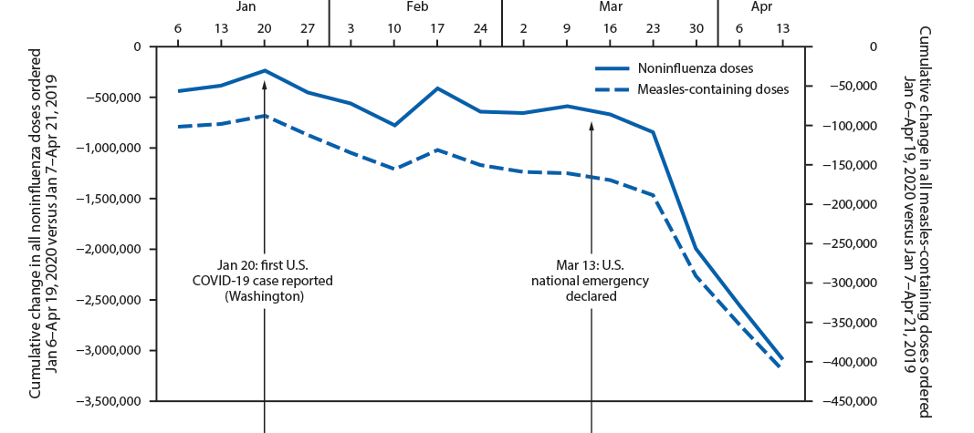
Reductions in Vaccination

Slide 19
What to do now?
Routine medical appointments have resumed over the past several months
Continues to be fear of exposures to COVID-19 at a medical appointment
Encourage catch-up vaccination for children who missed doses during lock down
Risks of serious vaccine preventable diseases remain, especially as children start interacting with others again

Slide 20
Resources
MDH Novel Coronavirus: http://health.maryland.gov/coronavirus
MDH Laboratory Coronavirus: https://health.maryland.gov/laboratories/Pages/Novel-Coronavirus.aspx
COVID-19 People at risk https://www.cdc.gov/coronavirus/2019-ncov/specific-groups/high-risk-complications.html
CDC Guidance for Infection Control https://www.cdc.gov/coronavirus/2019-nCoV/infection-control.html
Behavioral Health https://www.cdc.gov/coronavirus/2019-ncov/hcp/infection-control-faq.html?CDC_AA_refVal=https%3A%2F%2Fwww.cdc.gov%2Fcoronavirus%2F2019-ncov%2Finfection-control%2Finfection-prevention-control-faq.html
Memory Care https://www.cdc.gov/coronavirus/2019-ncov/hcp/memory-care.html

Slide 21
Questions?
Email : mdh.ipcovid@Maryland.gov

