Slide 1
Maryland Situation Update on Coronavirus Disease (COVID-19) for BHA
Maryland Department of Health
Infectious Disease Epidemiology and Outbreak Response Bureau
October 23, 2020

Slide 2
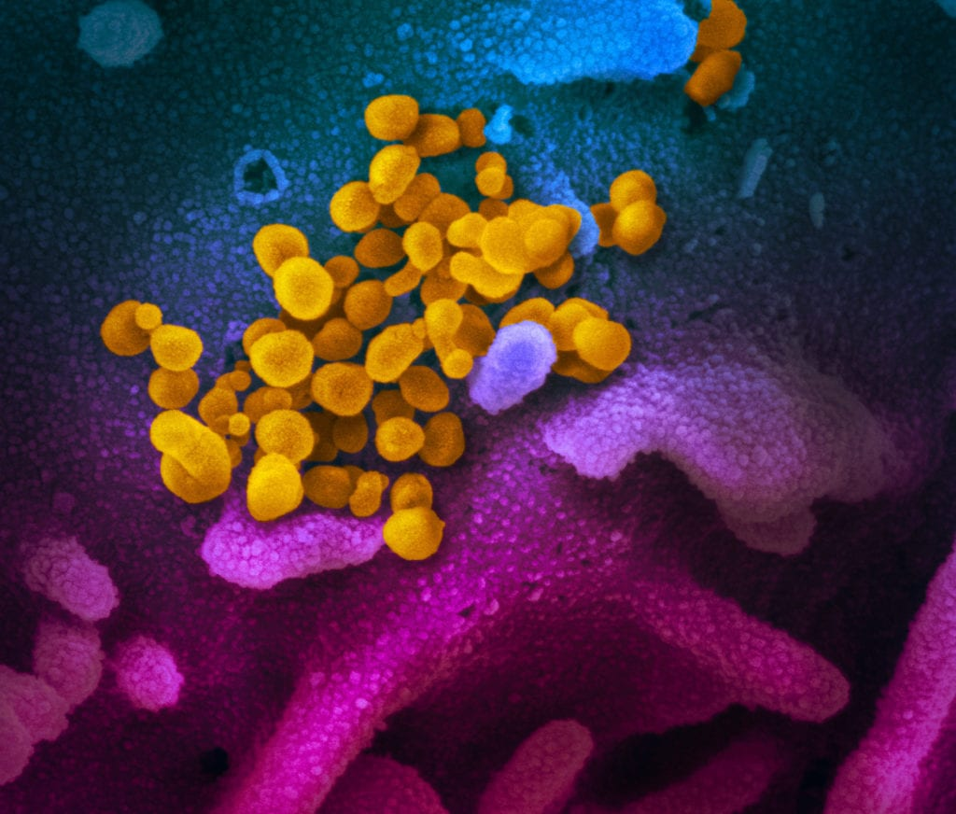
Call Agenda
Picture Courtesy of NIAID-RML
Review current situation of COVID-19
Guidance for Service and Therapy Animals

Slide 3
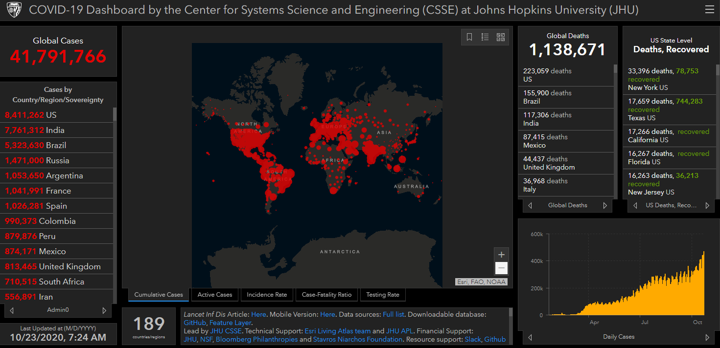
COVID-19 Global Situation Summary

Slide 4
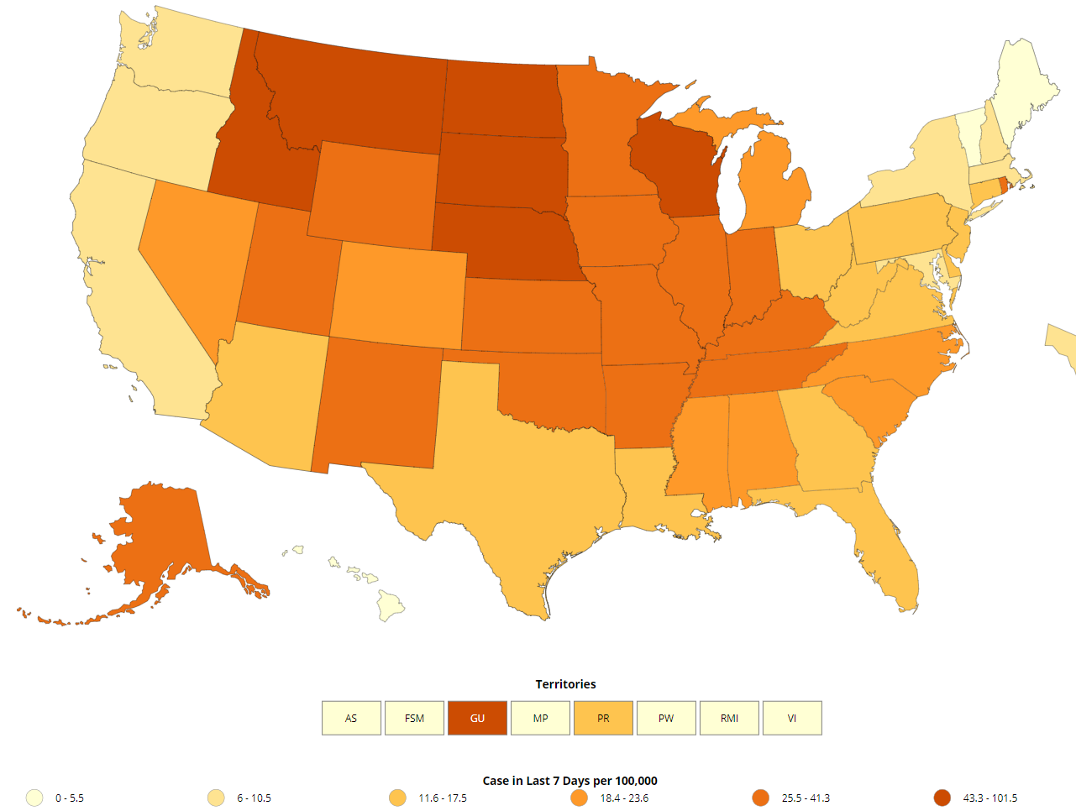
US: COVID-19 Case Rate per 100,000 in the last 7 days
https://www.cdc.gov/coronavirus/2019-ncov/cases-updates/cases-in-us.html Accessed 10/23/2020

Slide 5
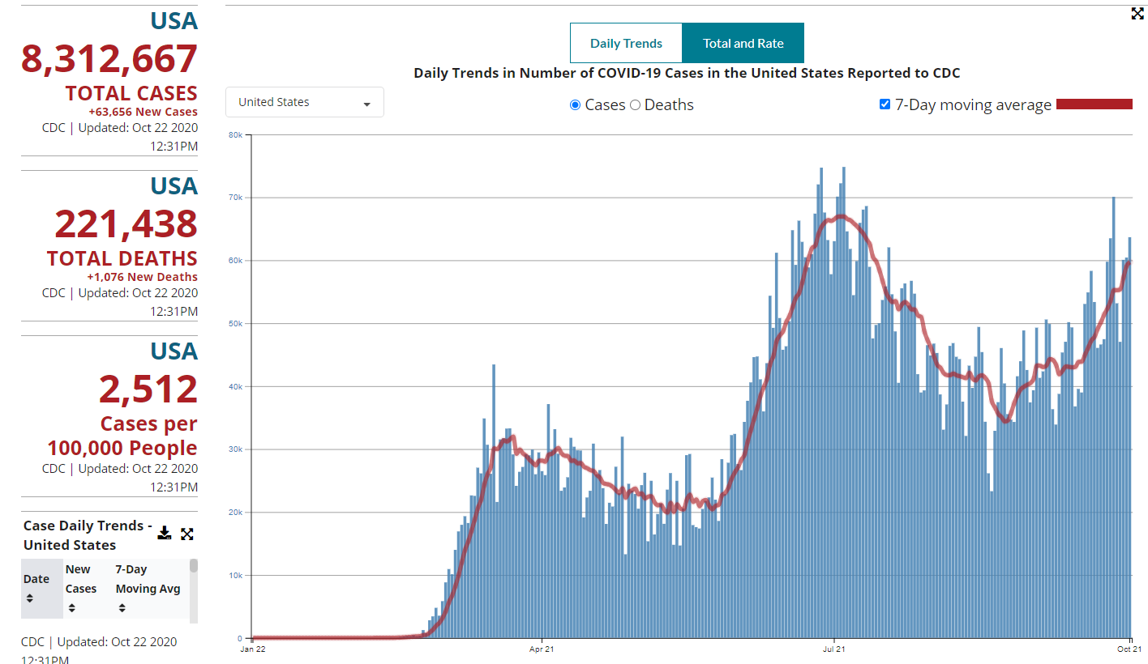
Number of Cases Reported in the USA, by Day

Slide 6
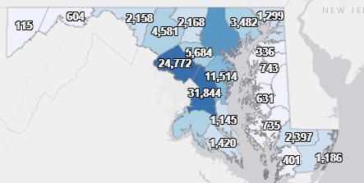
Maryland: COVID-19 Cases
http://health.maryland.gov/coronavirus
Data current as of 10/23/2020
Cases: 138,691
712 new
Deaths: 3,932
8 new
Hospitalizations: 16,462
Current: 458
Total tests performed: 3,201,774
Total people tested: 1,855,294

Slide 7
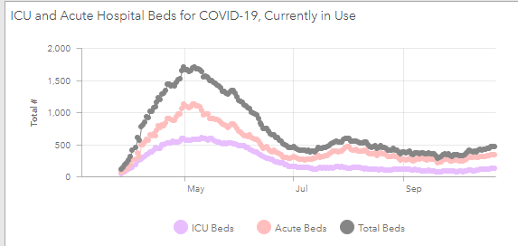
https://coronavirus.maryland.gov/ 10/23/2020

Slide 8
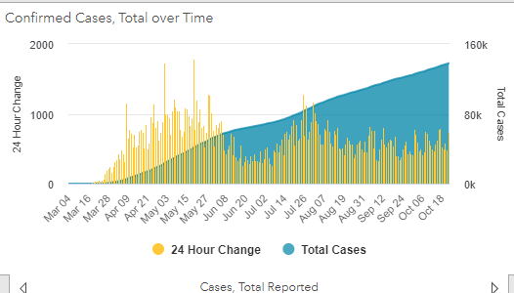

Slide 9
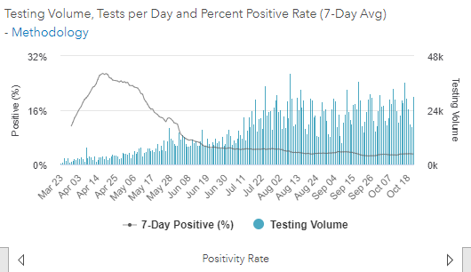
Testing Volume and % Positivity

Slide 10
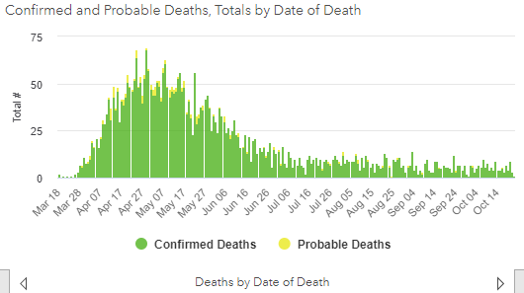

Slide 11
Maryland Updates
New Directives from 10/16/20
Allows 10% general occupancy at all outdoor sports venues and race tracks
Increases certain outdoor entertainment venues over the 250 limit to 10%
Maintains Indoor Sports Venues at 50% max occupancy or 100 persons, whichever is lesser; Prohibits tailgating at outdoor sports venues; spectators shall remain seated to the extent possible, mask/social distancing requirement, and keeps last week's 25% college sports provision under certain conditions
https://governor.maryland.gov/covid-19-pandemic-orders-and-guidance/

Slide 12
CDC Updates
The definition of close contact is now:
Within 6 feet (same as before)
For 15 minutes or more cumulative over a 24 hour period (i.e. three 5 minute contacts)
May increase the number of people who qualify as close contacts
Data are limited, making it difficult to precisely define “close contact;” however, 15 cumulative minutes of exposure at a distance of 6 feet or less can be used as an operational definition for contact investigation
Other Factors may include:
Whether the case was symptomatic (shedding more virus)
Activities that are more likely to generate aerosol (singing, shouting etc.)
Environmental factors (indoors vs outdoors, crowding, etc.)
Mask use is not a factor, except for PPE for HCP
https://www.cdc.gov/coronavirus/2019-ncov/php/contact-tracing/contact-tracing-plan/appendix.html

Slide 13
COVID-19 Guidance for Therapy and Service Animals
David A. Crum, DVM, MPH Prevention and Health Promotion Administration
Center for Zoonotic and Vector-borne Diseases
October 22, 2020

Slide 14
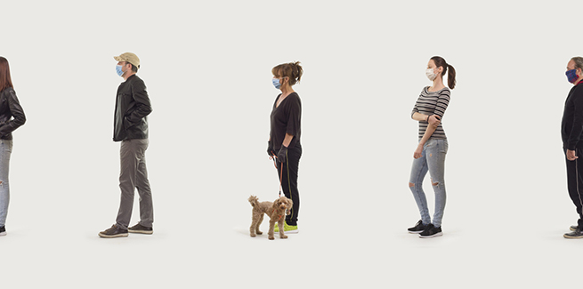
Overview
The One Health Concept
General Guidance
Therapy animals
Service animals
Resources
Source: CDC

Slide 15
What is One Health?

Slide 16
General Guidance
Based on the limited information available to date, the risk of animals spreading COVID-19 to people is considered to be low
It appears that the virus that causes COVID-19 can spread from people to animals in some situations
There is no evidence that the virus can spread to people from the skin, fur, or hair of pets
Source: CDC
Notes:
We are still learning about the virus that causes COVID-19, but it appears that the virus can spread from people to animals in some situations. CDC is aware of a small number of pets, including dogs and cats, to be infected with the virus that causes COVID-19, mostly after close contact with people infected with COVID-19.

Slide 17
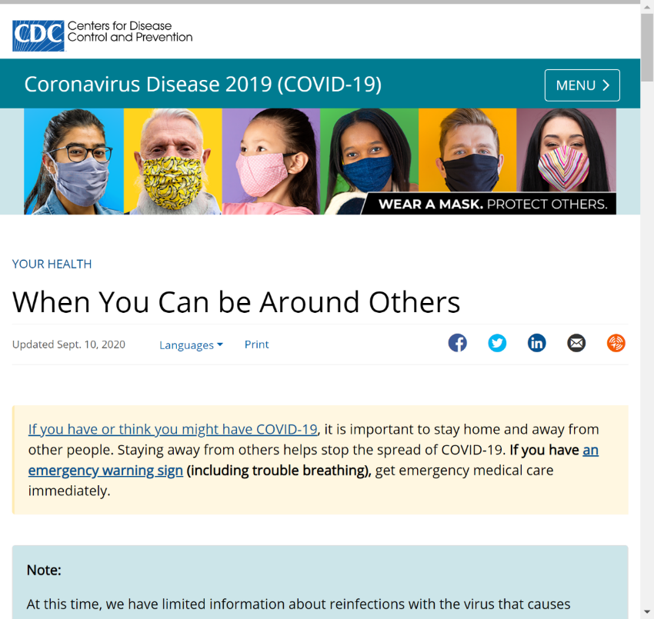
General Guidance
Consider local levels of COVID-19 transmission when evaluating the risk to yourself, your animal, and the people you might come into contact with
When deciding if it is safe to visit a household/facility, refer to CDC guidance When You Can be Around Others After You Had or Likely Had COVID-19
Source: CDC

Slide 18
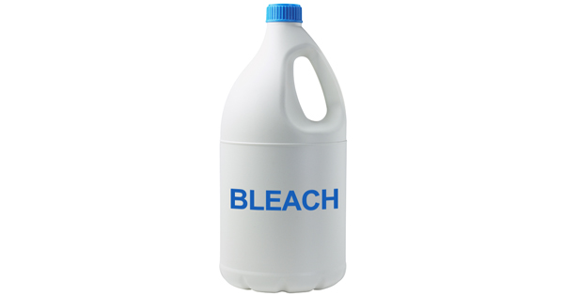
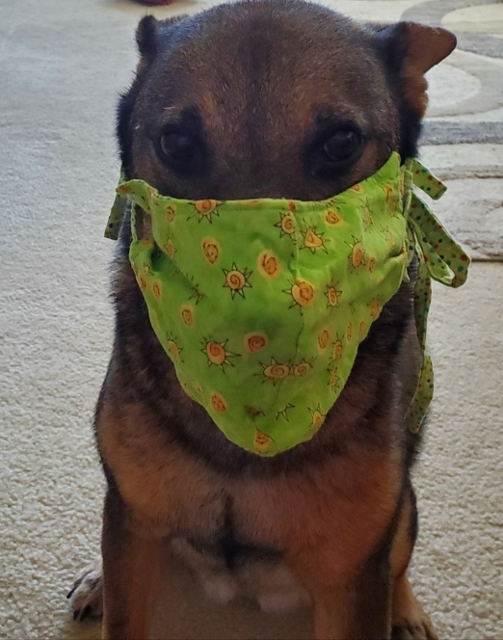
General Guidance
Do not wipe or bathe therapy or service animals with chemical disinfectants, alcohol, hydrogen peroxide, or other products, such as hand sanitizer, counter-cleaning wipes, or other industrial or surface cleaners
Do not put masks on therapy or service animals
Source: CDC

Slide 19
General Guidance
Disinfect items such as toys, collars, leashes, harnesses, therapy vests and scarves, and food/water bowls frequently
Before and after every contact, the handler and anyone having contact with the animal should wash their hands
Encourage people to talk to a veterinarian​ if they have questions regarding the health of their animal

Slide 20
Therapy Animals
Do not take therapy animals to visits if the animal is sick or has tested positive for the virus that causes COVID-19
When possible, keep animals at least 6 feet away from people and animals not participating in the visit
Handlers and participants should wear a mask during the visit
Notes:
Key Concept: Therapy animal visits require some level of contact between clients and the therapy animal team.

Slide 21
Therapy Animals
​People with symptoms of COVID-19 should not touch, be close to, or interact with therapy animals. If someone was sick with COVID-19, they should wait until they fully recover to interact with therapy animals
Do not use items that multiple people handle, particularly if items are brought to multiple facilities between therapy visits (for example, leashes, harnesses, toys, or blankets)

Slide 22
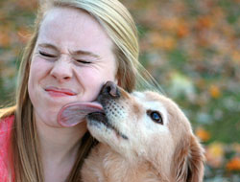
Therapy Animals
Do not let other people handle items that go into the animal’s mouth, such as toys and treats
Do not allow therapy animals to lick or give ‘kisses’
Source: CDC

Slide 23
Service Animals
A service animal is any animal trained to do work or perform tasks for the benefit of a person with a disability
A service animal is not considered a pet but rather an animal trained to provide assistance to a person because of a disability
Title III of the Americans with Disabilities Act of 1990 mandates that people with disabilities accompanied by service animals be allowed access with their service animals to places of public accommodation, including health care facilities

Slide 24
Service Animals
Service animals should not be excluded from such areas unless a patient’s situation or a particular animal poses risk that cannot be mitigated through reasonable measures
If health care personnel, visitors, and patients are permitted to enter care areas (e.g., inpatient rooms and public areas) without taking additional precautions to prevent transmission of infectious agents (e.g., putting on gloves, gowns, or masks), a clean, healthy, well-behaved service animal should be allowed access with its handler

Slide 25
Service Animals
Standard cleaning procedures are sufficient following occupation of an area by a service animal. Cleanup of animal urine, feces, or other body substances can be accomplished with blood/body substance procedures as outlined in the Centers for Disease Control and Prevention guidelines
Guidelines for environmental infection control in health-care facilities: recommendations of CDC and the Healthcare Infection Control Practices Advisory Committee (HICPAC). MMWR 2003; 52 (No. RR-10): 1–48. https://www.cdc.gov/hicpac/pdf/guidelines/eic_in_HCF_03.pdf pdf icon[PDF-5M]

Slide 26
Service Animals
If a service animal is sick, call a veterinarian, and do not go out in public with the animal
Both the handler and animal should stay at least 6 feet away from others
Avoid settings in which people are infected with COVID-19 or facilities where you can’t prevent interactions with people who may have COVID-19
If contact cannot be avoided, sick persons should wear a mask when around the animal
Notes:
Service animals may encounter other people and animals while working

Slide 27
Resources
Service Animals
https://www.ada.gov/service_animals_2010.htm
Therapy Animals
https://www.avma.org/resources-tools/animal-health-welfare/service-emotional-support-and- therapy-animals
When You Can be Around Others After You Had or Likely Had COVID-19
https://www.cdc.gov/coronavirus/2019-ncov/if-you-are-sick/end-home-isolation.html
COVID-19 Cleaning and Disinfecting
https://www.cdc.gov/coronavirus/2019-ncov/prevent-getting-sick/disinfecting-your-home.html
Pets and COVID-19
https://www.cdc.gov/coronavirus/2019-ncov/daily-life-coping/pets.html
COVID-19 FAQ
https://www.cdc.gov/coronavirus/2019-ncov/faq.html#COVID-19-and-Animals

Slide 28
Questions?
Email : mdh.ipcovid@Maryland.gov

